Slide 1
Android Development
Hello Custom UI

Slide 2
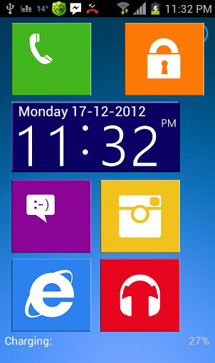
Hello Custom User Interface
To build custom View with custom Style so as to make the app UI just look like the snapshot, and every clickable items could just show toast after clicked
It can be applied as the View widget both for both mobile and tablet according to different width and height

Slide 3
Hello Custom UI
Delivery Date: Before 2014.12.19 6pm
Send your homework to
android.academy.bjtu@gmail.com
Format of mail subject as below:
[groupID|personalID][FullName]Hello Custom UI

